Slide 1

International Accreditation Service
The International Accreditation Service (IAS) is a nonprofit, public-benefit corporation that has been providing accreditation services since 1975. As one of the leading accreditation bodies in the United States, IAS is a Mutual Recognition Arrangement (MRA) signatory of the Asia Pacific Laboratory Accreditation Cooperation (APLAC) and the International Laboratory Accreditation Cooperation (ILAC).

Slide 2

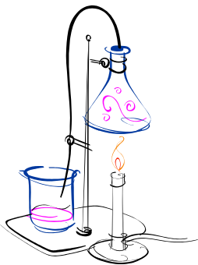
The IAS laboratory accreditation program is modeled on the international standard ANS/ISO/IEC Standard 17025:2005, General Requirements for the Competence of Testing and Calibration Laboratories and is recognized globally by the International Laboratory Accreditation Cooperation and the Asia Pacific Laboratory Accreditation Cooperation, and nationally by the National Cooperation for Laboratory Accreditation.

Slide 3
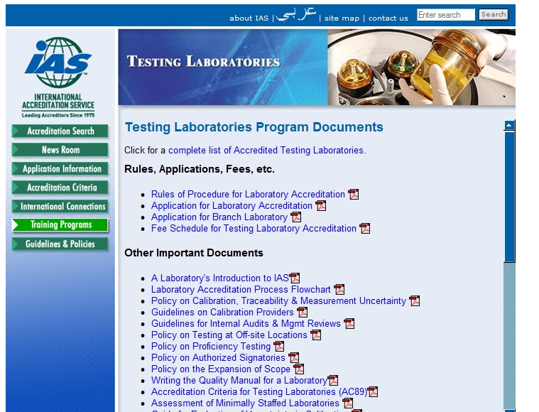

Slide 4

Gridlines for internal audits and management reviews
http://www.iasonline.org/PDF/Forms/ct-iamr_policy.pdf

Slide 5
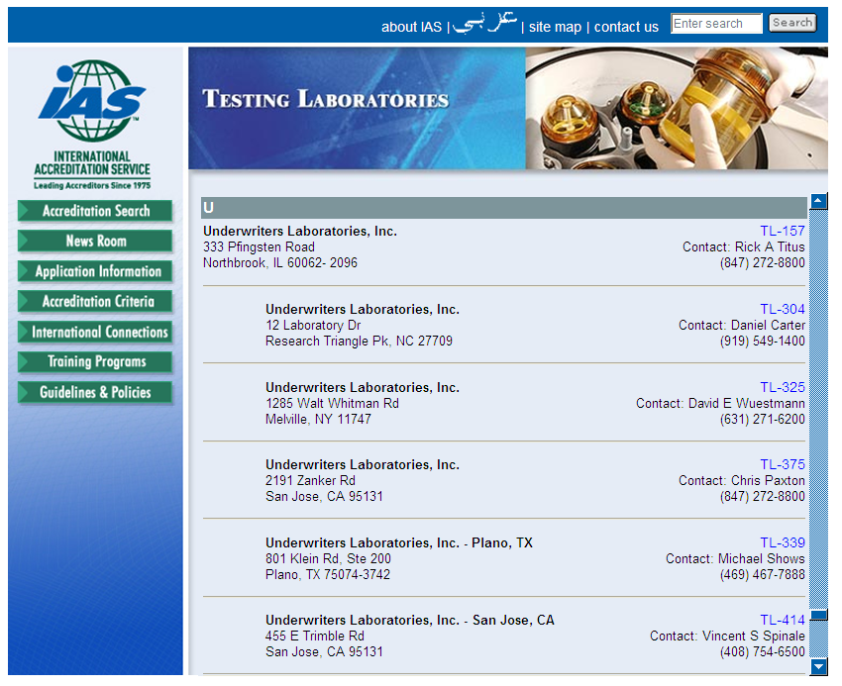

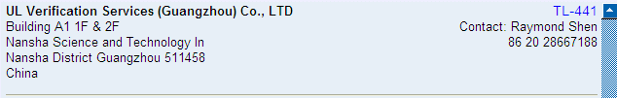



Slide 6
The Accreditation Process
IAS accredits testing laboratories by verifying technical competence and assessing their quality systems to the international standard ANS/ISO/IEC Standard 17025:2005.
The process begins with the testing laboratory’s submittal of an application, applicable fees, and a quality manual.
The assessment team conducts an on-site assessment of the laboratory and develops an assessment report.
Once a laboratory has satisfied IAS accreditation requirements and demonstrated competence, an accreditation certificate is issued.

Slide 7

The Accreditation Process
IAS will conduct an on-site reassessment of accredited laboratories at a minimum of once every two years, for verification of continued compliance with IAS accreditation requirements.

Slide 8
ACCREDITATION CRITERIA FOR TESTING LABORATORIES
Document AC89: Accreditation Criteria for Testing Labs.
Must show compliance with ANS/ISO/IEC 17025
Testing laboratories that perform internal calibrations must meet all applicable requirements of the IAS Laboratory Accreditation Program Policy Guide on Calibration , Traceability, and Measurement Uncertainty.
“Calibration certificates and/or reports held by IAS accredited
testing laboratories must meet the requirements of
ANS/ISO/IEC Standard 17025:2005”
Documents available at: www.IASonline.org

Slide 9

Proficiency Testing and Interlaboratory Comparisons
ILAC Policy for Participation in National and International
Proficiency Testing Activities: Document ILAC-P9:2005
“Proficiency testing (PT) is the determination of the calibration or testing performance of a laboratory or the testing performance of an inspection body by means of interlaboratory comparison.”

Slide 10
Proficiency Testing and Interlaboratory Comparisons
IAS supports the use of PT/ILC as an improvement tool. PT/ILC is required for IAS laboratory accreditation, and IAS is working with its national and international partners to ensure that necessary and appropriate PT/ILC is available for laboratories in all fields.

